Slide 1
Capstone Engagement
Assessment, Analysis, and Hardening of a Vulnerable System
Presented by: Andrew Benga

Slide 2
Table of Contents
This document contains the following sections:
01
Network Topology
02
Red Team: Security Assessment
03
Blue Team: Log Analysis and Attack Characterization
Hardening: Proposed Alarms and Mitigation Strategies
04

Slide 3
Network Topology
‹#›

Slide 4
Recon: Describing the Target
Nmap identified the following hosts on the network:
Hostname | IP Address | Role on Network
Hyper-V Azure Machine - ML-RefVm-684427 | 192.168.1.1 | Host machine Azure Cloud based
Kali | 192.168.1.90 | Attacking Machine
Capstone | 192.168.1.105 | Target Machine Replicating a vulnerable server
ELK- Server | 192.168.1.100 | Network Monitoring Machine running Kibana

Slide 5
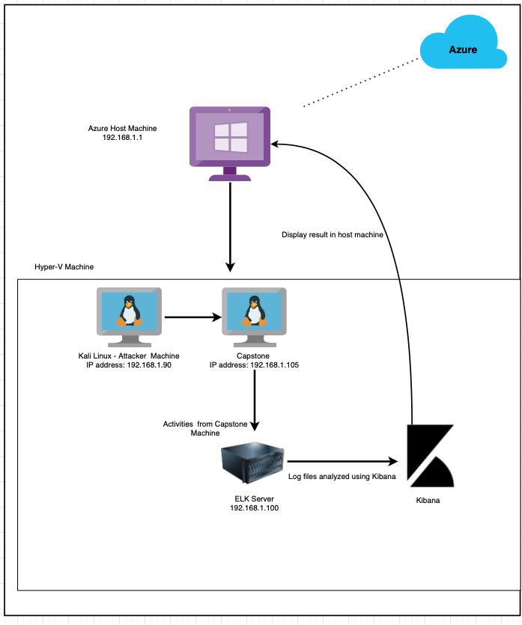
Network Topology
Network
Address Range:
192.168.1.0/24
Netmask: 255.255.255.0
Gateway:10.0.0.1
Machines
IPv4: 192.168.1.1
OS: Windows 10 Pro 64 bits
Hostname: ML-RefVm-684427
IPv4:192.168.1.90
OS: Linux 2.6.32
Hostname:Kali
IPv4: 192.168.1.100
OS: Linux
Hostname:ELK-Stack
IPv4:192.168.1.105
OS: Linux
Hostname: Capstone

Slide 6

Red Team
Security Assessment
‹#›

Slide 7
Vulnerability Assessment
The assessment uncovered the following critical vulnerabilities in the target:
Vulnerability | Description | Impact
Port 80 was open to the public with access CVE-2019-6579 | Port 80 was open and unsecured anyone attempting can gain access. | Files and folder that contain secret PII were readily accessible.
Root accessibility | Authorization to execute and command different application and access to resource on the vulnerable device. | Vulnerabilities can be severe, potential impact can be done to any connected network.
Weak password | Commonly used password, dictionary words, the lack of password complexity such as inclusion of numbers, symbols and uppercase letters. | Names can be discovered by social engineering and attacker can easily gain access to secret files and folder.
Simplistic username | First name, last name, short names can be easily socially engineered | Simple names can be easily discover and with a weak password can attained files/folder.

Slide 8
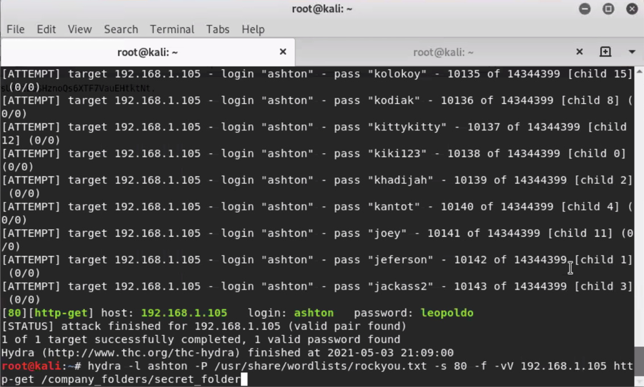
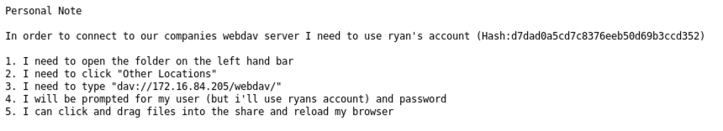
Exploitation: Brute Force Password
01
Tools & Processes
We utilized Hydra to exploit the vulnerability
Command: hydra -l ashton -P /usr/share/wordlists/rockyou.txt -s 80 -f -vV 192.168.1.105 http-get /company_folders/secret_folder
02
Achievements
What did the exploit achieve? This exploit achieved access to Ashton’s password encoded file which contained the details to access the company_folders/secret_folder.

Slide 9
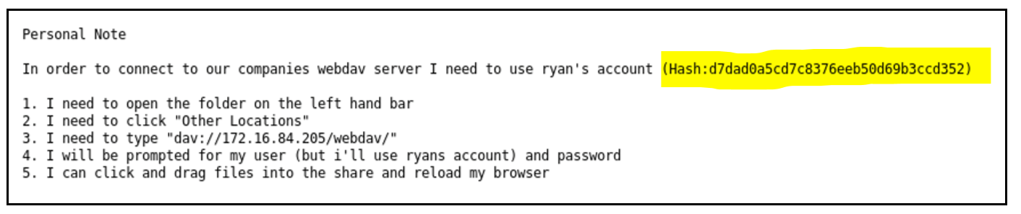
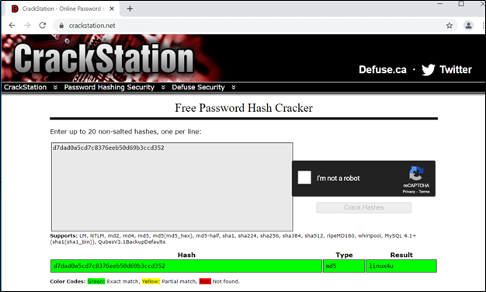
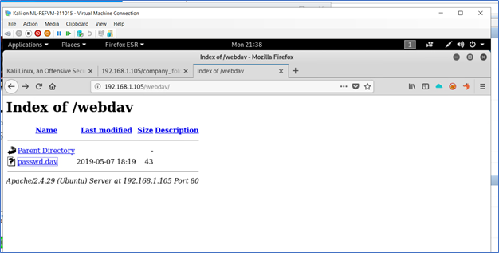
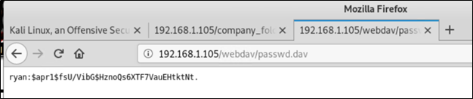
Exploitation: Weak Password Vulnerability
01
02
Tools & Processes
To exploit the vulnerability we utilized CrackStation to decrypt the hash for the password to Ryan’s file.
03
Achievements
By using CrackStation we accessed Ryan’s password: linux4u
This provided us access to the password.dav file
04

Slide 10
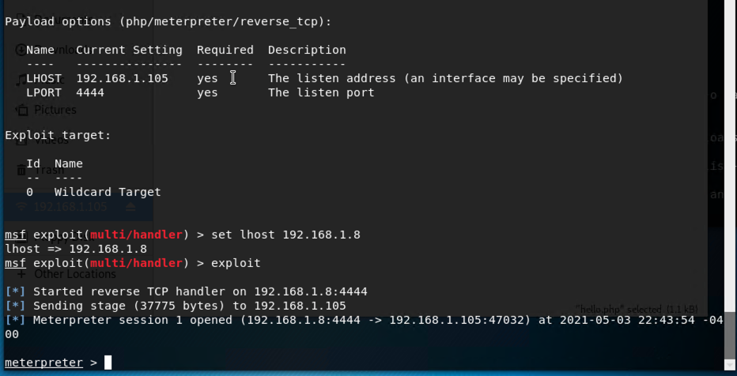
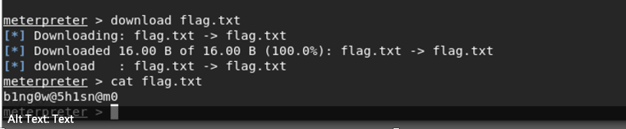
Exploitation: PHP reverse shell exploit
01
Tools & Processes
How did you exploit the vulnerability? We utilized meterpreter to set a payload on port 4444 and IP address 192.168.1.105.
02
Achievements
What did the exploit achieve? This granted us access to this host and port location to enter a payload to gain access to the file that accesses the flag

Slide 11

Blue Team
Log Analysis and Attack Characterization
‹#›

Slide 12
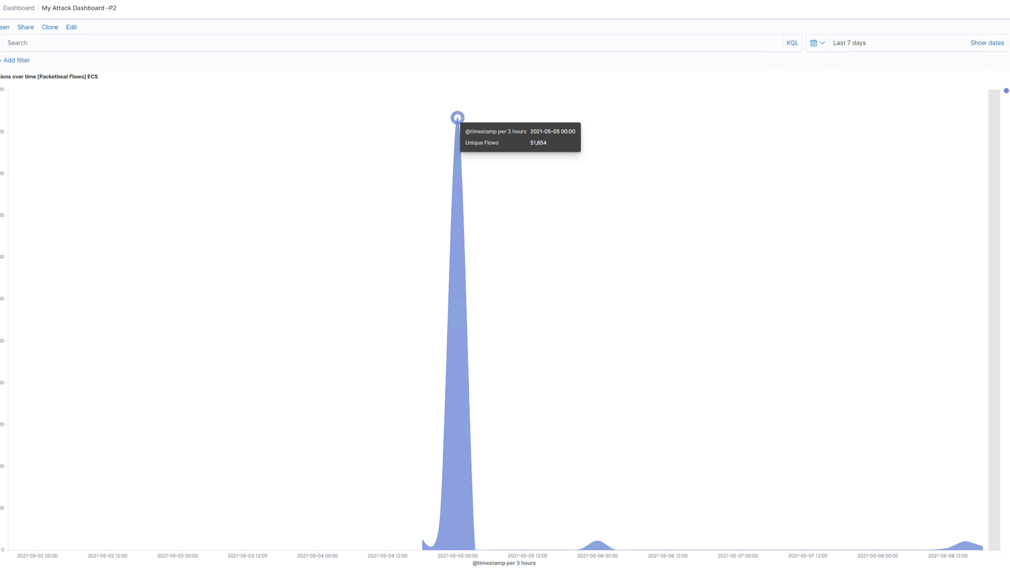
Analysis: Identifying the Port Scan
The port scan was started May 5th, 2021 at 00:34:26.306 (12:34 AM)
There were 51,654 packet sent from source IP 192.168.1.90 (Kali Machine)
Port 80

Slide 13
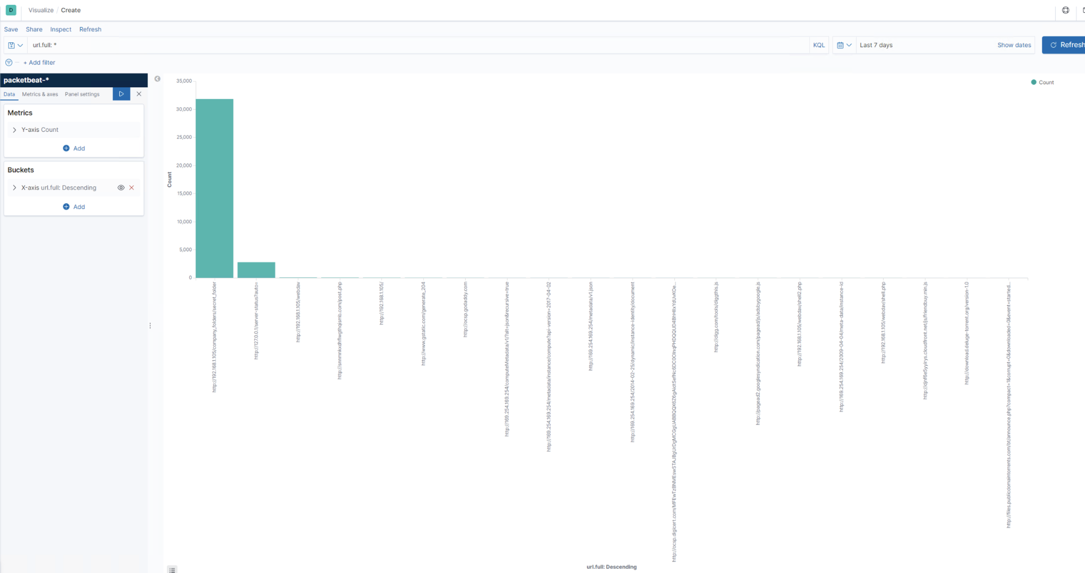
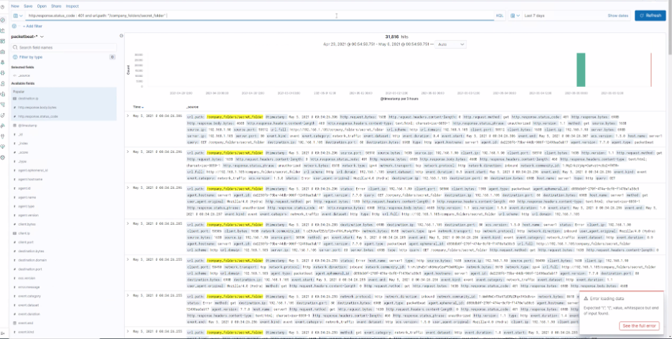
Analysis: Finding the Request for the Hidden Directory
The amount of Request and time of ip address: url.path= 31,827 during time frame of May 4 11:59:59 – May 5 3:01:58
File requested and contains of the file: company_folders/secret_folder it includes login information

Slide 14
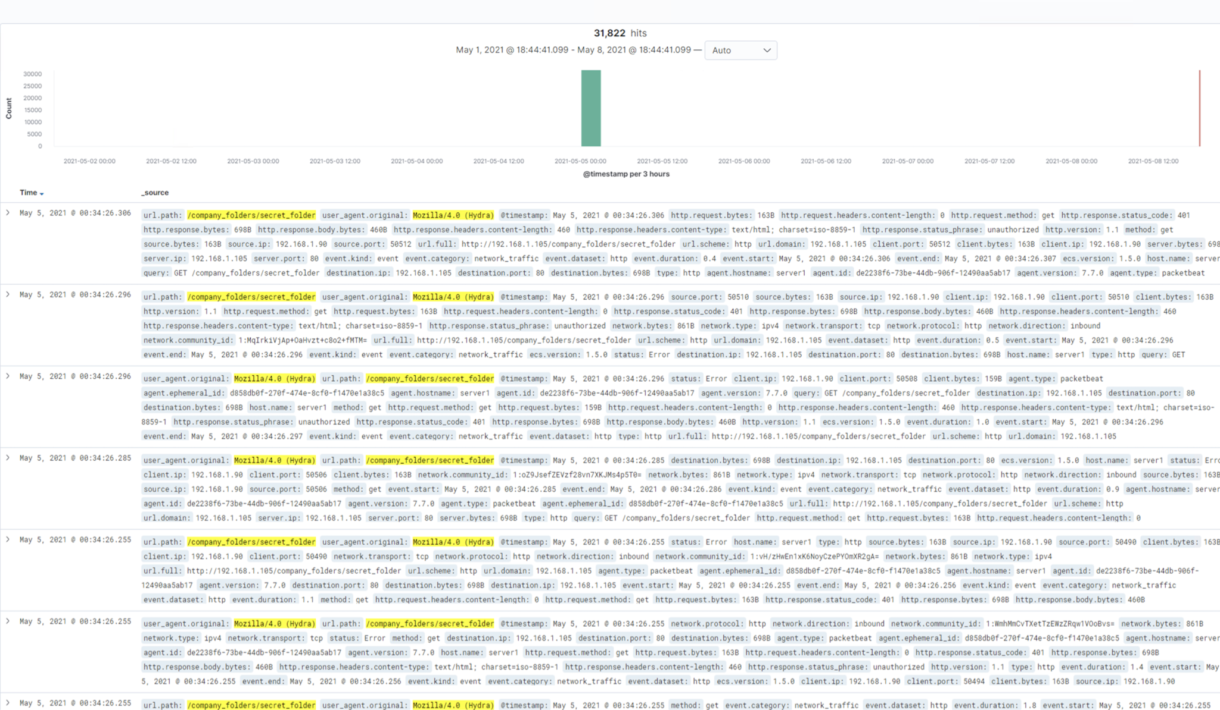
Analysis: Uncovering the Brute Force Attack
31,822 request made (all traffic generated by hydra)
How many requests had been made before the attacker discovered the password? 31,814
4 requests were successful

Slide 15
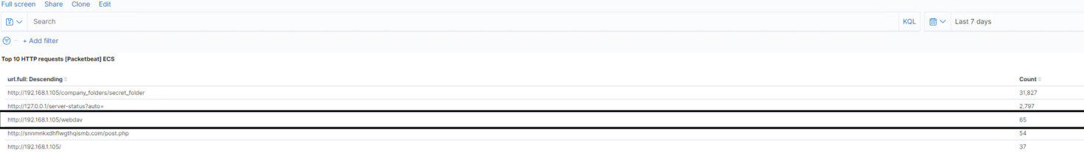
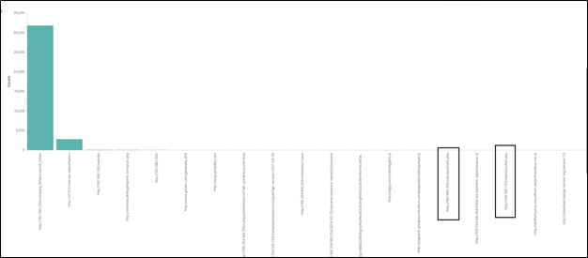
Analysis: Finding the WebDAV Connection
65 Request were made to gain access to /webdav
Shell. Php was the file requested

Slide 16
Blue Team
Proposed Alarms and Mitigation Strategies
‹#›

Slide 17
Mitigation: Blocking the Port Scan
Run a system port scan using nmap to search and detect any open ports and block all that are not in use.
Ensure the firewall is regularly patched to minimise new zero-day attacks
Ensure the firewall detects and cuts off the scan attempt in real time and blacklist all offending IP’s
An hourly alarm on the IDS could be set for over 1000 TCP connections

Slide 18
Mitigation: Finding the Request for the Hidden Directory
We would set an alarm for failed logins reaching the threshold 10 or more requests/hour
Implement IP whitelisting to prevent unauthorized data access
Encrypt network traffic and stored data so that it isn’t shown as plain text
Use multi-factor authentication for all logins
Set up anti-malware protection to ensure malware doesn’t get installed

Slide 19
Mitigation: Preventing Brute Force Attacks
To prevent future Brute Force attacks with an alarm, we would set any amount of request that are outside the type range. IE: (less than 2,000 events, 7 days)
The alarm would trigger when the events reach the threshold (IE: 1,500 events)
Create a policy that will lock out the accounts after a set time limit and unsuccessful attempts.
Time Limit: 20 minutes
Unsuccessful attempts: 3 attempts
Create a policy that requires complexity for password creation. Also, compare passwords to common password lists and restrict historical password usage.
Create a block list of IP address that pertain to unsuccessful over a time period
Time limit set to 3 months. If the IP address is a team member, required training will be implemented.

Slide 20
Mitigation: Detecting the WebDAV Connection
We set up an alarm that detects php because we are aware that an a possible attack can be execute php and can detect connections to port 4444. Also, we will change the port to port 53 so we less likely to be detected.
We set a threshold to trigger under an alarm anytime there is php event/executable event.
If the server is not a php server, block php from the server or alert when anyone uploads a php file.
Look for inconsistent network traffic to the given ports as well as unknown or unfamiliar executable files such as php files as listed above.

Slide 21
Mitigation: Identifying Reverse Shell Uploads
We would recommend to review all IP addresses, and filter out ones that can be added to the whitelist. This can prevent any reverse shells
Establish the /webDav folder to a read only to avoid any payloads to be uploaded
Assure that all appropriate ports are open and secure all other ports to be clean
Ensure there are no executable files (such as php files when they aren’t allowed)
We would recommend to set up an alarm with an email and text to our On Call SOC analyst when traffic hits port 4444.
We would recommend setting up an alert for all files that are being uploaded into the /webDAV folder. Also, set the threshold to alert when an attempt is being made

Slide 22



